Slide 1
Using Theatre of the Oppressed to explore and heal trauma
Daniel Domaguin
Deborah Kawkeka (Kickapoo)
2017 American Indian and Alaska Native Behavioral Health Conference
Tulsa, OK
August 15-17, 2017

Slide 2
Objectives
Understand the benefits of integrating embodied art into behavioral health treatment, particularly for conflict, suicide prevention and addiction
Implement at least three Theatre of the Oppressed techniques into treatment practice
Explore the theoretical and historical foundations of Theatre of the Oppressed

Slide 3
Why is understanding trauma important? (SAMHSA, 2012)
To provide effective services, we need to understand the life situations that may be contributing to the person’s current life problems
Many current problems faced by the people we serve may be related to traumatic life experiences
People who have experienced traumatic life events may be very sensitive to situations that remind them of the people, places, or things involved in their traumatic event
  These reminders (triggers) may cause a person to relive the trauma and view our setting/organization as a source of distress rather than a place of healing and wellness

Slide 4
Non-trauma vs trauma informed
What’s wrong with you?
What has happened to you?

Slide 5
Trauma-influenced behaviors
Conflict
Suicidality
Addiction

Slide 6
How can creative arts expression,
embodied art in particular,
be trauma informed?

Slide 7
Anna Reyner, MA
“Art is a safe way to express our feelings; it helps us express ourselves slowly and at our own pace. Art goes beyond words and tells our story for us. It helps us delve into our true selves and express our pains and heartaches that language does not have the ability or power to convey.
Feelings that stem from trauma, violence, or abuse are often overwhelming and words alone rarely capture or convey their true intensity. Pictures tell us far more than words can ever express. Tapping into our artistic selves and creative mind can help provide a whole world of self-discovery.
Art is the best healing tool possible when we are feeling emotions that are too painful, too deep, too hidden to access—much less to express.”
From the essay “How Art Heals Us”

Slide 8
Creative arts expression and trauma informed care
Recognizes difficulty in dealing with trauma and its symptoms
  Client can go at their own pace
Is client-focused and -centered: provider may not exhibit power/control over client
  “You must do BLANK treatment”
The creation of art can be a collaborative, back-and-forth, shared process between provider and client

Slide 9
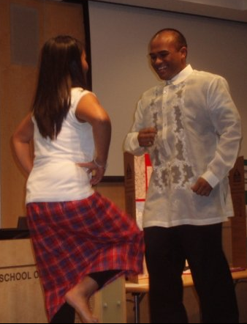
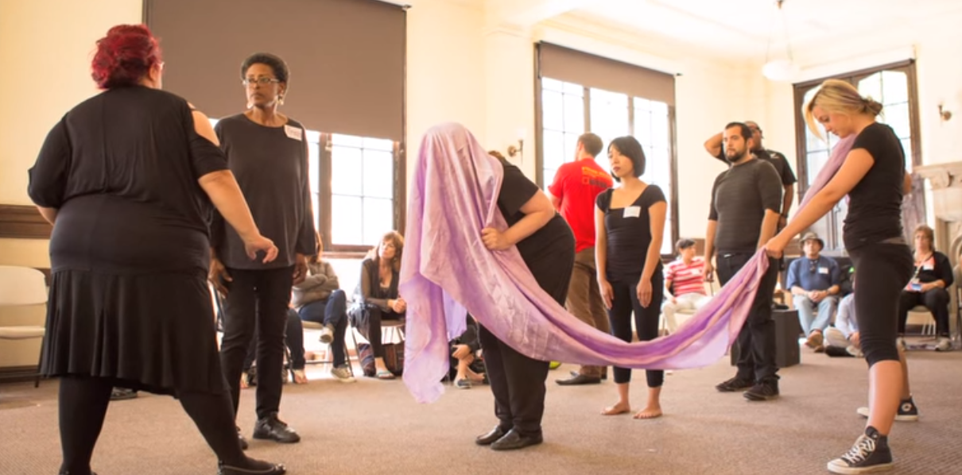
Embodied art
Allows client to express emotions and thoughts using their body
Exhibiting certain body poses/postures can cause hormonal changes that configure the brain to feel more assertive
and comfortable
vs shut-down
(Cuddy, 2012)
Retrieved from https://youtu.be/tY7LsNRAz4w

Slide 10
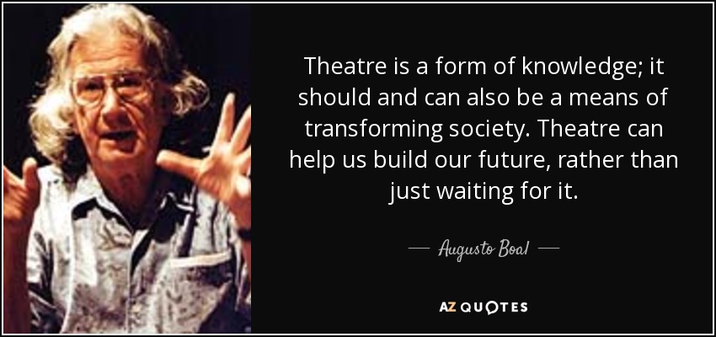
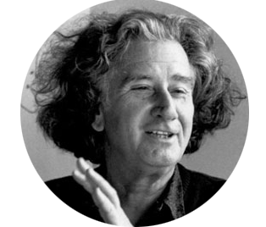
Theatre of the Oppressed
Founded during a period of political upheaval and military dictatorship in 1960s Brazil by theatre practitioner/chemist Augusto Boal
Created to resist governmental oppression and corruption, during a time that theatre was outlawed
Retrieved from http://www.azquotes.com/picture-quotes/
Retrieved from http://dramaresource.com/wp-content/uploads/2014/12/boal-1.png

Slide 11
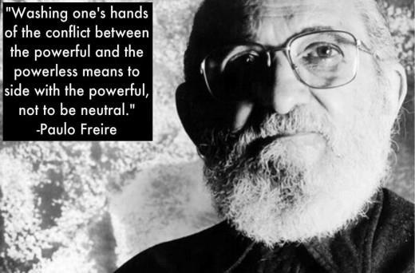
Theatre of the Oppressed
Inspired by Paolo Friere’s seminal work Pedagogy of the Oppressed, which rejects “traditional” Western education’s “banking model” of filling empty vessels (students) with knowledge, instead calling on building of critical consciousness among students/teachers/society
Retrieved from https://biaesmer.files.wordpress.com/2014/03/paulo_freire_a.jpg

Slide 12
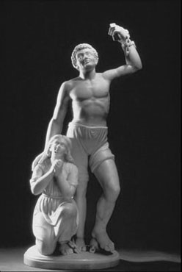
Some principles of TO
The basic aim of the Theatre of the Oppressed is to humanize Humanity.
Every human being is theatre!
Theatre is defined as the simultaneous existence - in the same space and context - of actors and spectators. Every human being is capable of seeing the situation and seeing themselves in the situation.
The oppressed are those individuals or groups who are socially, culturally, politically, economically, racially, sexually, or in any other way deprived of their right to Dialogue or in any way impaired to exercise this right.
“Forever Free,” Edmonia Lewis (Mississauga Ojibwe), marble, 1867

Slide 13
What does
“oppression”
look like?

Slide 14
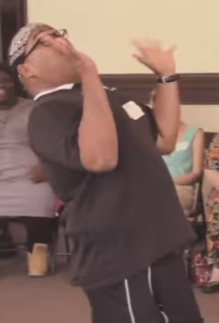
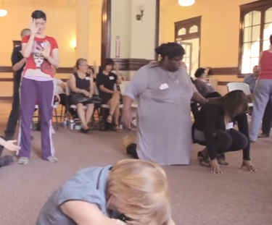
In vivo TO exercises
Gift Game
Machines
Statues
Museum of the Unspeakables
Retrieved from https://youtu.be/tY7LsNRAz4w

Slide 15

A Window Between Worlds
Mission
A Window Between Worlds is dedicated to cultivating and supporting a network of transformative arts programs that empower individuals and communities impacted by violence and trauma.
Vision
A Window Between Worlds views art as a catalyst to release trauma, build resilience and ignite social change. When individuals create art in a safe community they can be heard and respected — replacing violence and shame with safety and hope.
Website: http://awbw.org

Slide 16
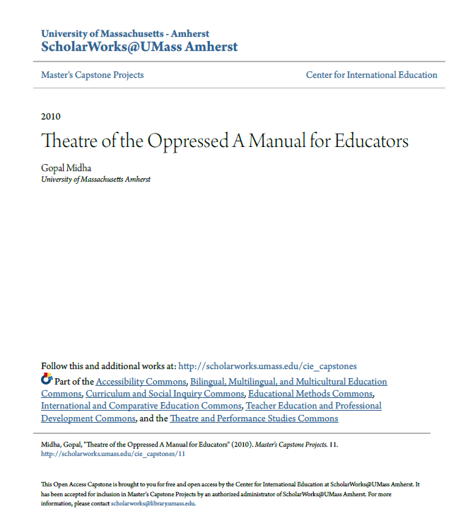
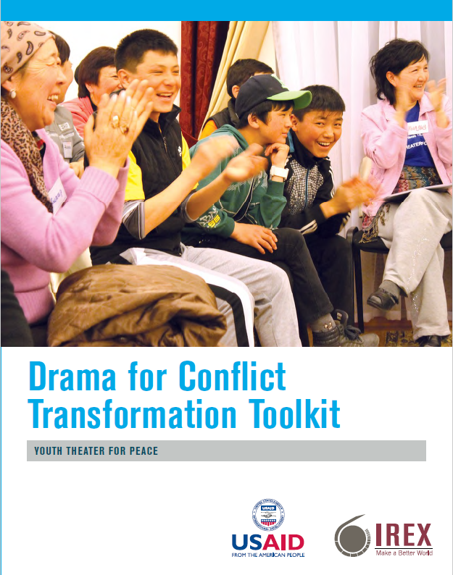
Free TO resources

Slide 17
Discussion
How may these exercises assist in approaching:
  Conflict
  Suicidality
  Addiction
Thoughts
Wonders
Observations

Slide 18
Works cited
A Window Between Worlds. (2014). Windows Theatre of the Oppressed Community Gathering. Retrieved from https://youtu.be/tY7LsNRAz4w
Cuddy, Amy. (2012). Your body language may shape who you are. TED Talk retrieved from https://www.ted.com/talks/amy_cuddy_your_body_language_shapes_who_you_are/transcript?language=en#t-786345
Reyner, A. (2015). How art heals us. Retrieved from http://www.care.uci.edu/docs/How-Art-Heals_AWBW.pdf
SAMHSA. (2012). The ABCs of trauma informed care. Retrieved from https://www.integration.samhsa.gov/mai-coc-grantees-online-community/ABCs_of_Trauma-New.pdf

Slide 19
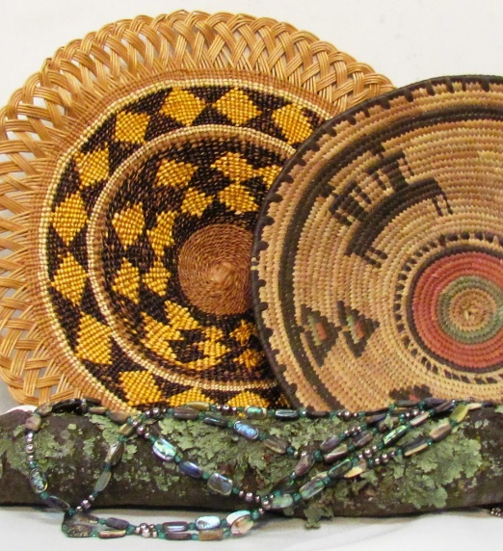
Thank you!
Daniel Domaguin
  Behavioral Health Clinical Manager
  (916) 929.9761 x1516
  ddomaguin@crihb.org
Deborah Kawkeka (Kickapoo)
  Training Coordinator
  (916) 929.9761 x1514
  dkawkeka@crihb.org

